Slide 1

Repair Kopitiam Electrical Training
By: Yeo Kheng Meng
http://www.slideshare.net/yeokm1/repair-kopitiam-electrical-training
https://github.com/yeokm1/repair-kopitiam-training-and-equipment
http://yeokhengmeng.com/2016/05/repair-kopitiam-speciality-electrical-tools/
For Repair Kopitiam Training

Slide 2
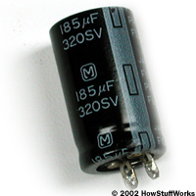
General Safety
Avoid touching appliance when plugged in
Unplug main power when before dismantling
If you see large capacitors, wait 1 minute for them to discharge before touching item.
Be careful of heating elements, iron, kettle, rice cooker etc.
Infrared thermometer
Put your hand close but not touching
Beware of moving parts like motors in fans, hair dryer and vacuum cleaner
Look out for sharp corners/protruding parts

Slide 3
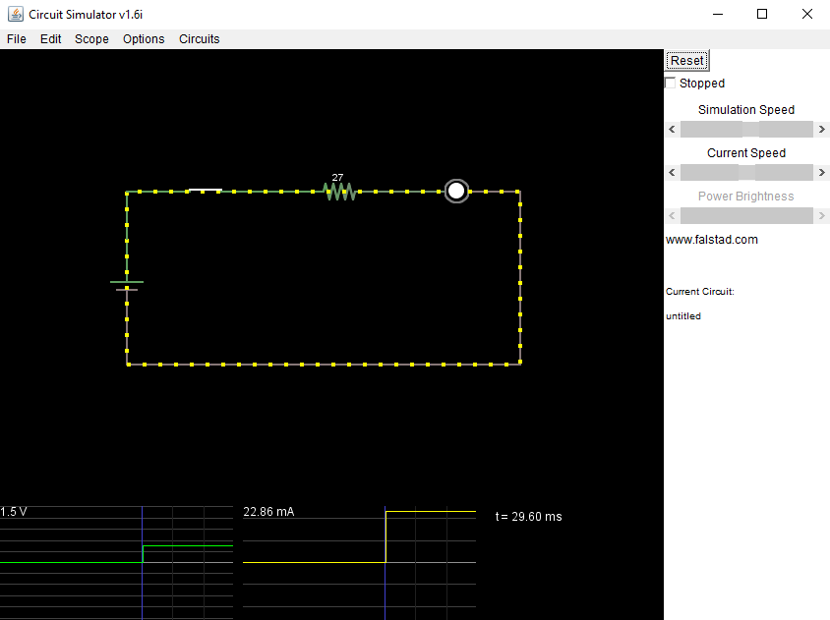
Direct-current (DC)
DC power source
Battery operated devices like toys, remote controls
Current flows in one direction from + to -

Slide 4
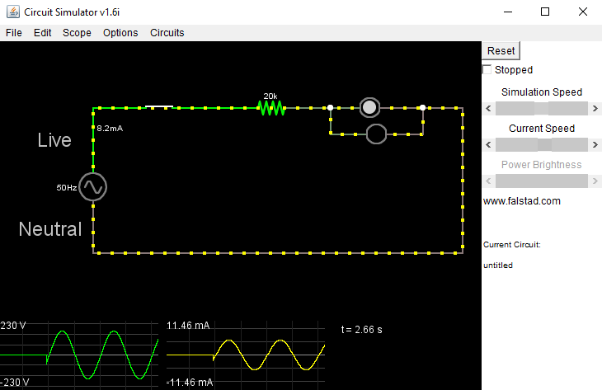
Alternating current (AC)
AC power source (mains)
Household appliances: iron, kettle, rice-cooker etc
Current changes direction regularly between Live and Neutral
Voltage
230V nominal/50Hz (220V-250V range)
Current
13 Amps max on typical sockets

Slide 5
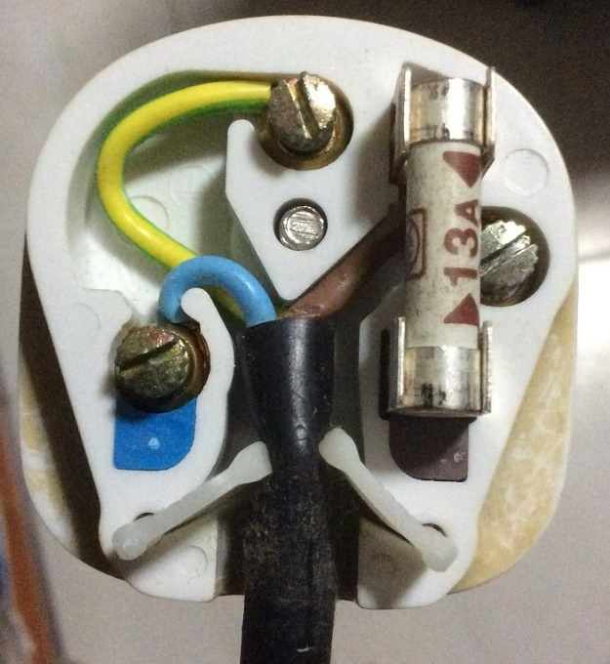
Inside the 3-pin mains plug (BS1363)
Earth
Yellow/Green
Connects to appliance’s external case, protects user from electric shock
Fuse
Neutral
Blue/Black
Completes the circuit to generator
Live
Brown/Red
Source of power
REMEMBER THE COLOURS BY HEART!!!

Slide 6
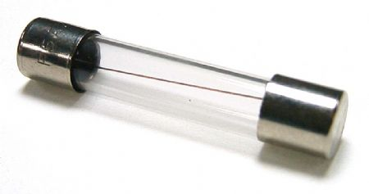
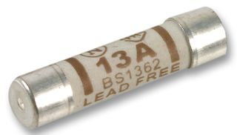
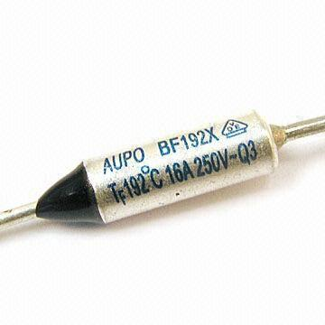
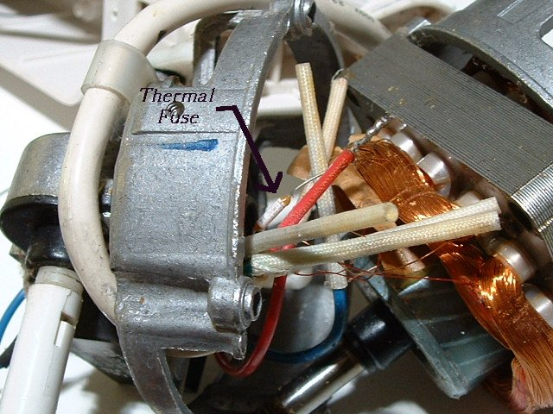
What is a fuse?
Wire in a container
Burns and breaks when limits exceeded
Types of fuse
Current fuse
Breaks when current limit exceeded
Usually found in mains plugs
Thermal fuse
Breaks when temperature exceeded
Found in heat-generating appliances
Iron, kettle, rice-cooker, etc
Usually covered by insulation sleeve
Why have a fuse?
To protect the device from further damage

Slide 7
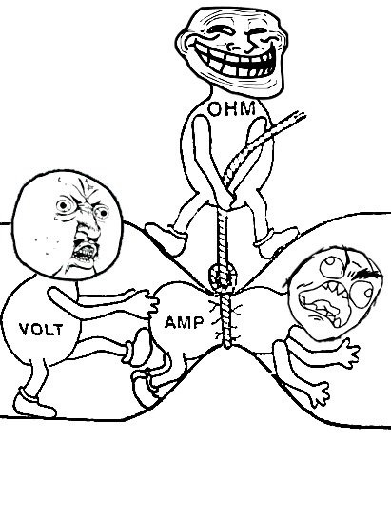
“Everything” you need to know about V = IR

Slide 8
Remember these equations?
V = IR
P = IV
Equation | Description | Units
V = IR | Voltage = Current x Resistance | Voltage (V) = Amperes (A) x Ohm (Ω)
P = IV | Power = Current x Voltage | Watt (W) = Amperes (A) x Voltage (V)

Slide 9
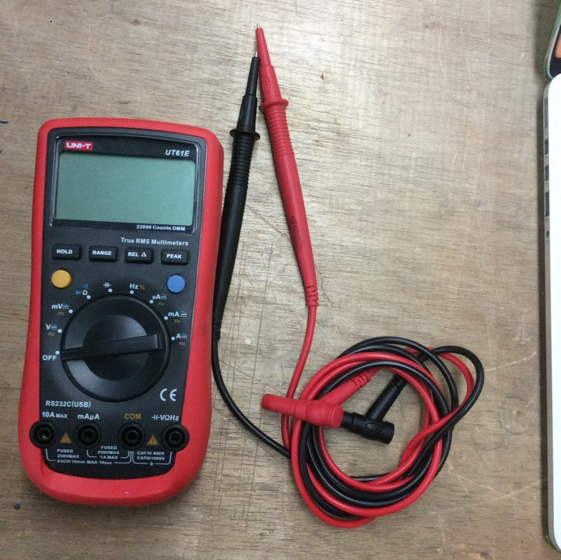
Your most important tool
The multimeter

Slide 10
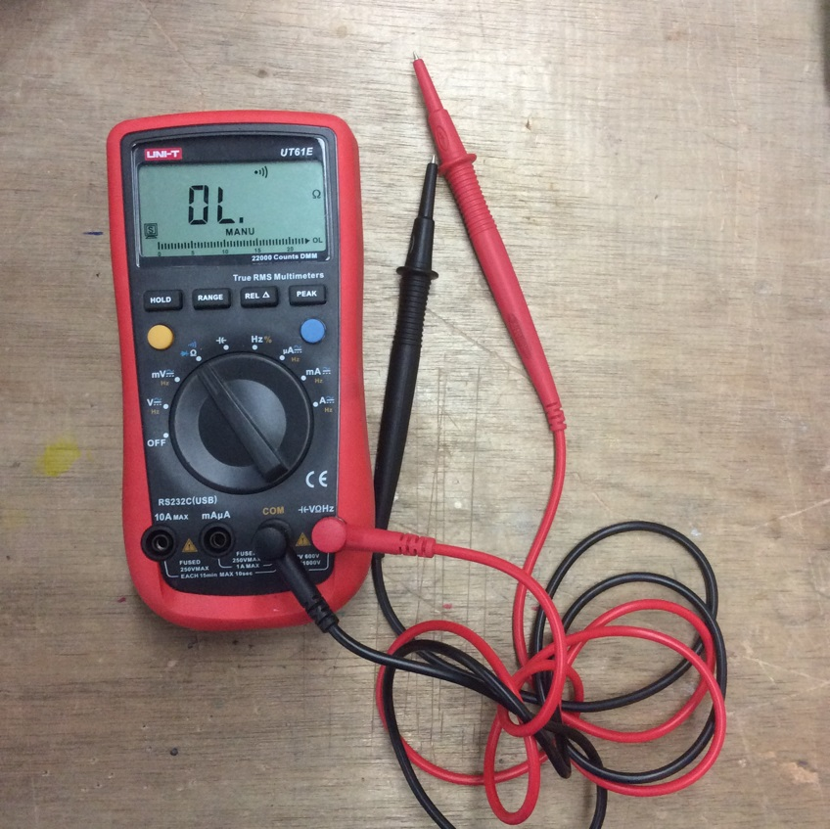
Continuity mode
Measures electrical conductivity between 2 points.
Beeps when electric current can flow with negligible resistance
Commonly used to check fuses and wire connectivity

Slide 11
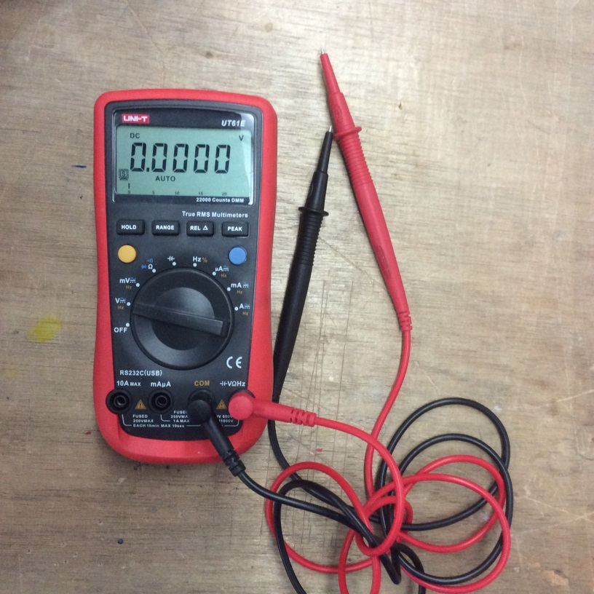
Voltmeter mode
Measures potential difference between 2 points
Can be used to measure battery voltage, socket output etc
Try measuring a battery. See what happens when you do it in reverse.

Slide 12
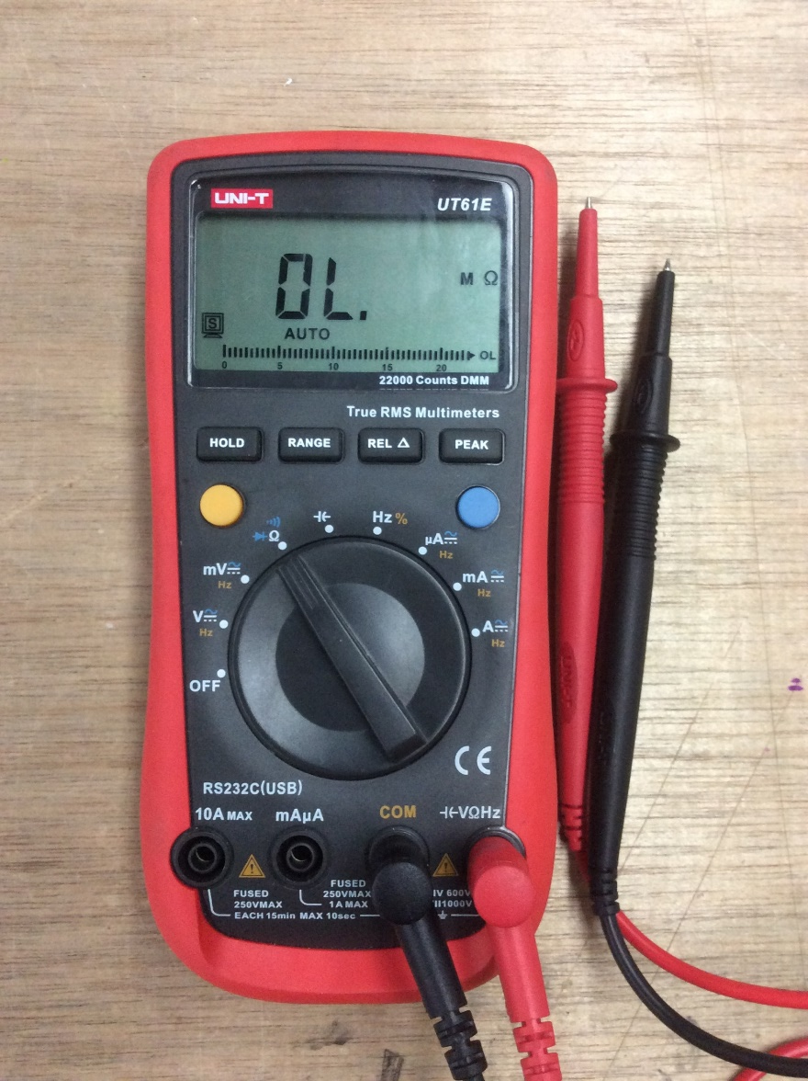
Ohmmeter mode
Measures resistance
Can be used to verify if a heating element/motor is operating as expected

Slide 13
Check if the heating element is working properly?
Use V = IR and P = IV to derive resistance (R)
Get values for Power and Voltage from label
Eg, P = 2300W, V = 230V
Measure the resistance of the heating element
Is it close?

Slide 14
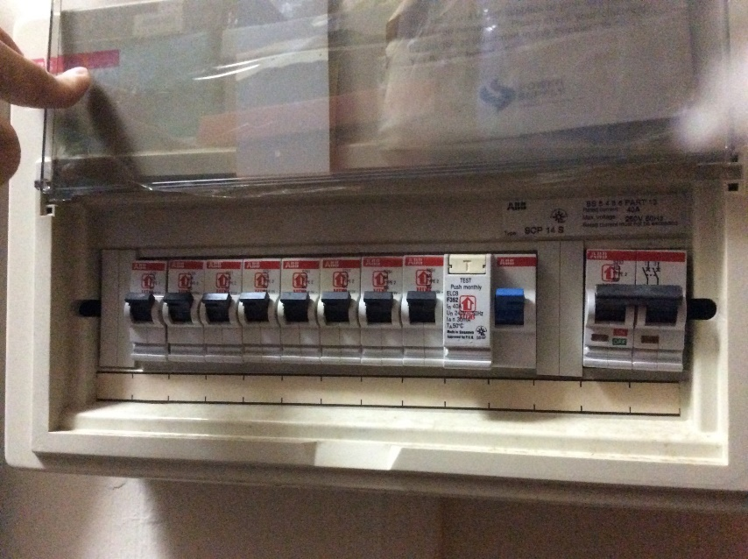
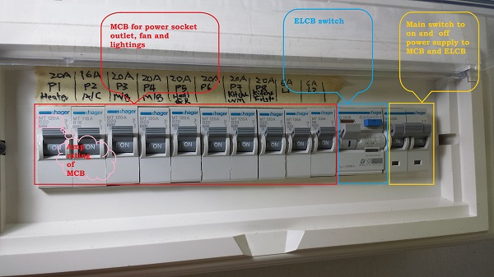
House blackout? What to do?
http://asktony.sg/blog/let-there-be-light-part-1/
-> Earth-leakage circuit breaker (ELCB) trips
Why? Current detected on Earth wire
Turn off every electrical device
Flip ELCB switch to ON
Turn on ONE device at a time. If ELCB trips again, you have found your spoilt device.
Prioritise simple devices like lamps/ovens. Computers and refrigerators are sensitive to repeated power cycles.
Unplug that spoilt appliance
Flip ELCB back on.

Slide 15
ELCB shortcomings
Breaker depends on wiring/appliance’s Earth wire.
Will fail if Earth wire is damaged anywhere
Certain appliances do not have Earth wire
Casing damage can expose Live wires
Will not detect flaw if leakage is to external earth like water pipes
Sudden change in earth line potential can cause unwanted trip

Slide 16
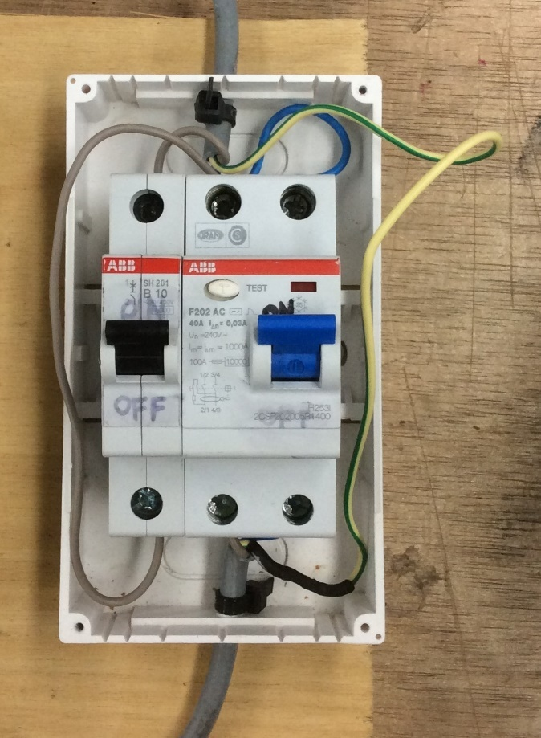
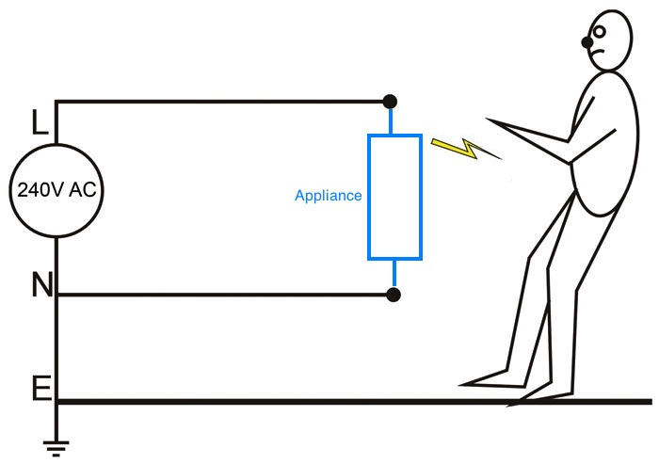
Residual Current Circuit Breaker (RCCB)
Breaks when difference between live current and neutral current > threshold (usually 30mA)
Extra: Kirchhoff's first law (sum of currents at a node in = out)
Does not depend on Earth wire
Greater use over last 15 years, replaced ELCB
Picture modified from:
http://www.soundonsound.com/sos/nov06/articles/crosstalk_1106.htm

Slide 17

Miniature Circuit breaker (MCB)
MCB trips when current exceeds rated threshold
Protects against overcurrent and short-circuit
Usually connected in series with ELCB/RCCB

Slide 18
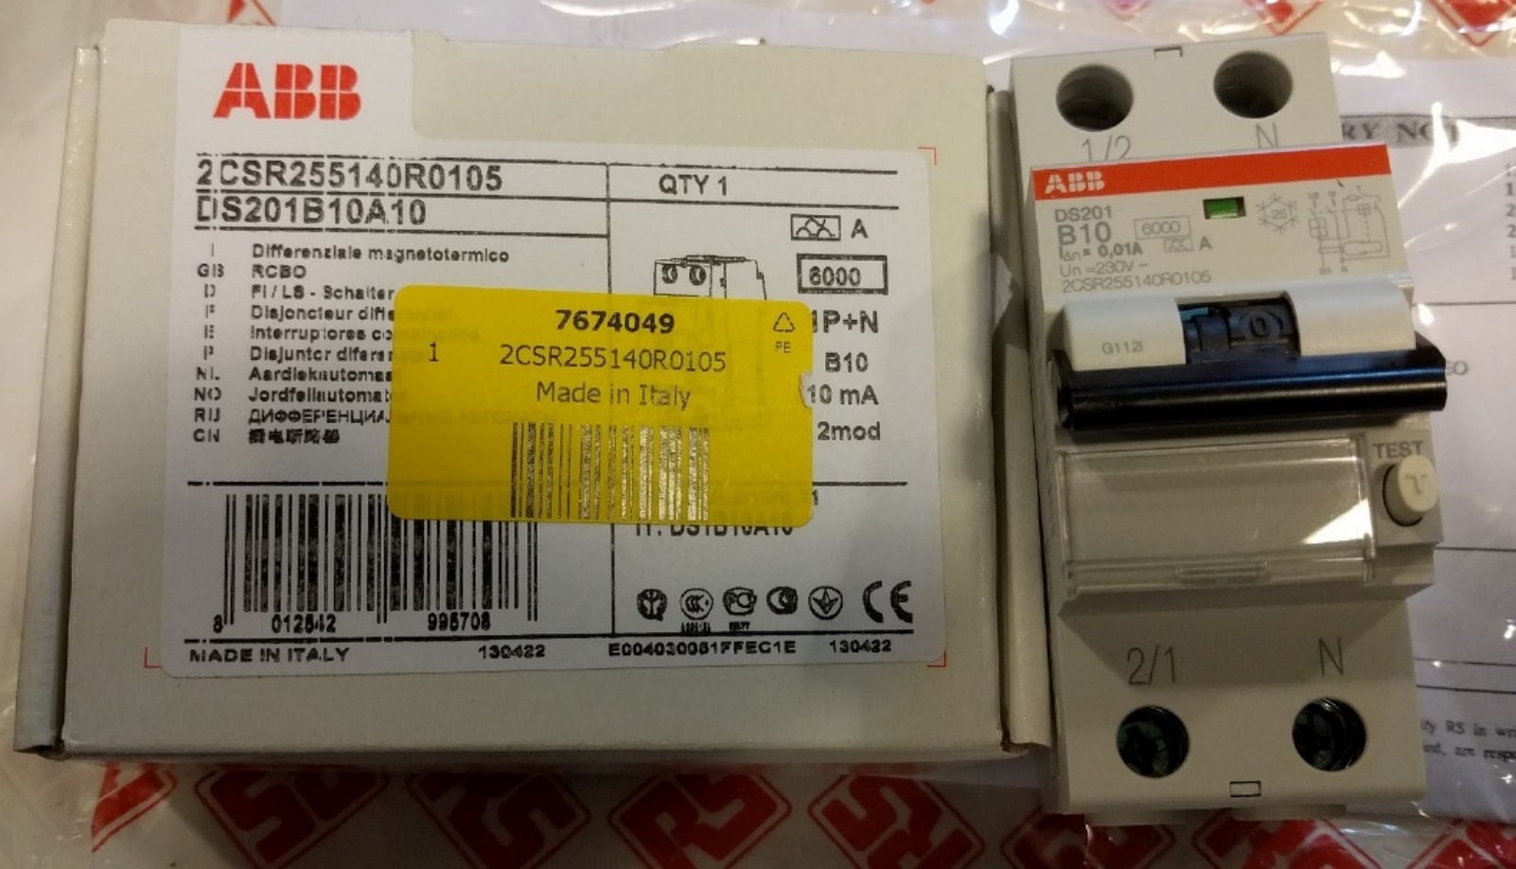
RCBO
Residual Current Circuit breaker with Overload protection
RCBO = RCCB + MCB

Slide 19
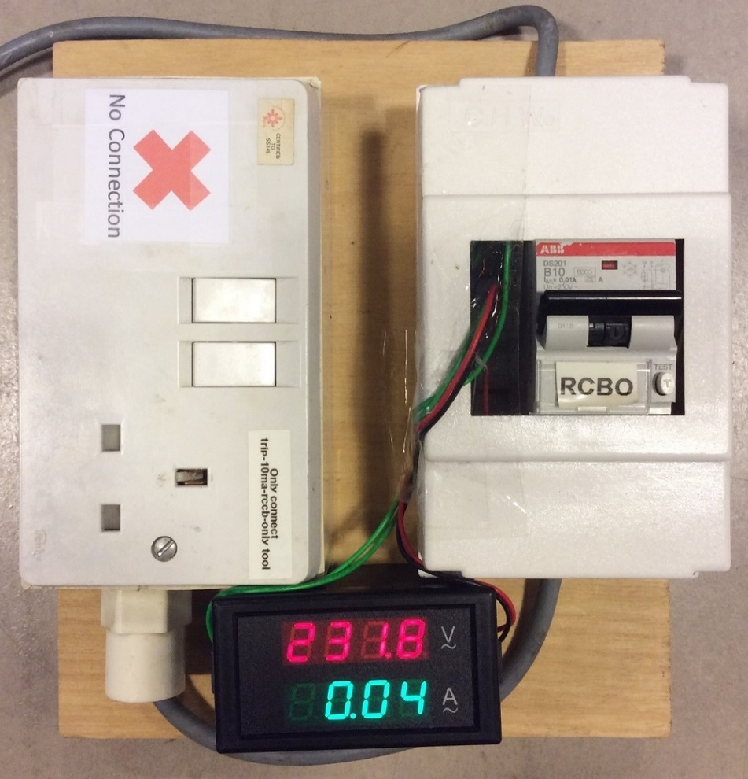
RK’s RCBO with voltmeter/ammeter
Our RCBO at 10mA earth leakage
Typical ones trip at 30mA
Increased safety for us
Overload trip 30A to 50A (Type B)

Slide 20
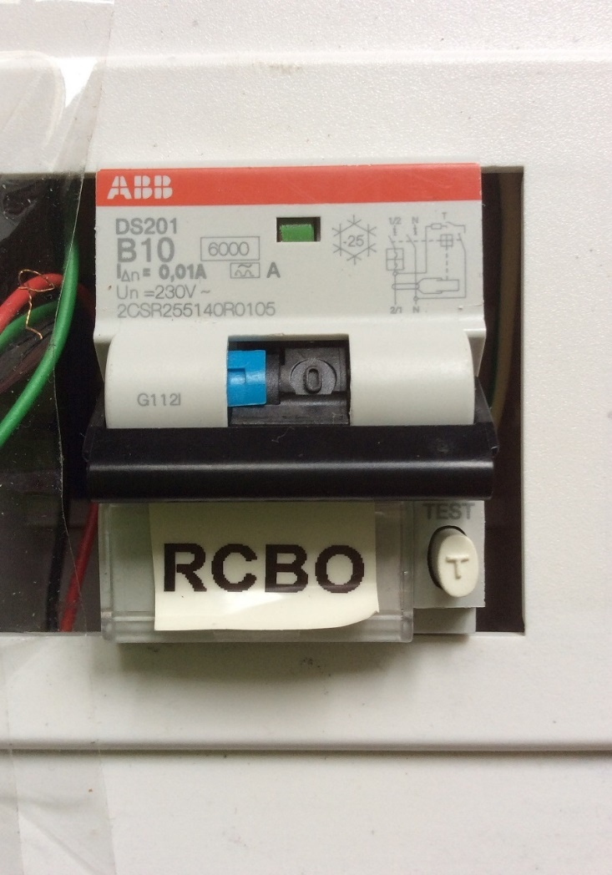
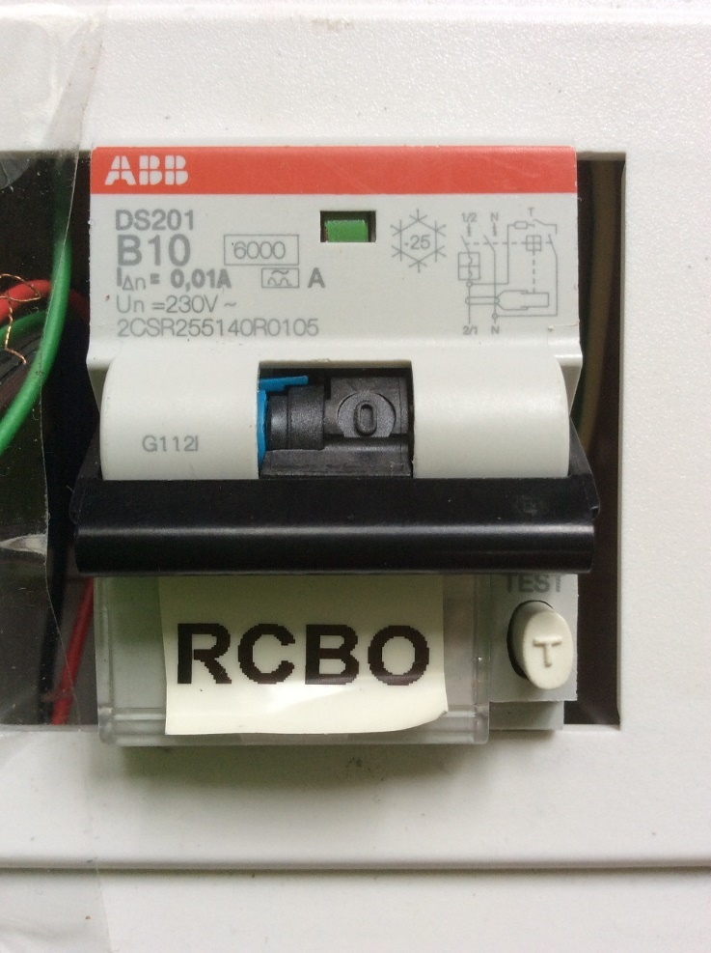
RCBO trip status
Earth trip: Switch and blue tab is down
Overload trip: Only switch is down

Slide 21
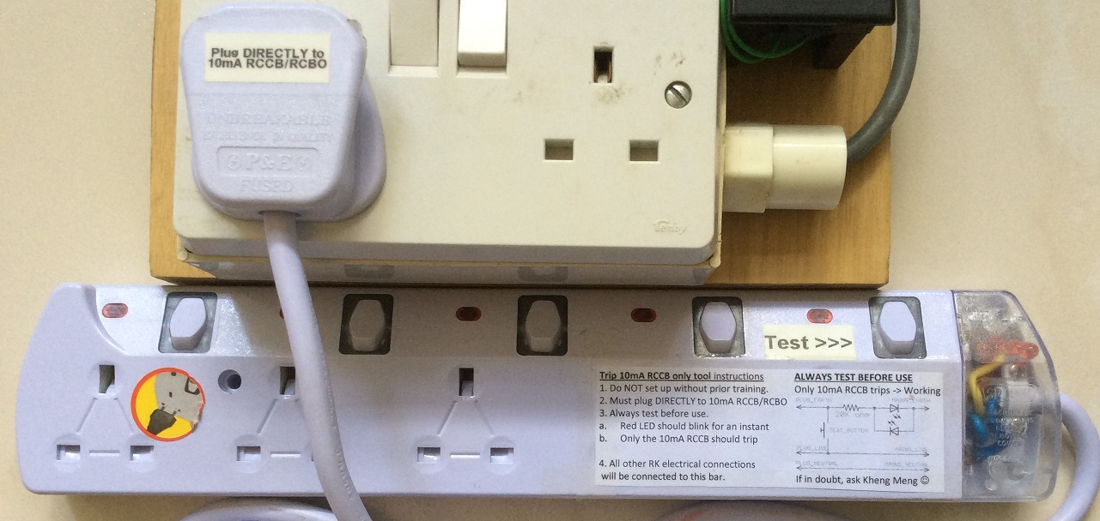
trip-10ma-rccb-only-tool (Demo)
Only trips RK’s RCBO if earth fault is found
Must plug directly to 10mA RCBO
Familiarise with usage instructions beforehand

Slide 22
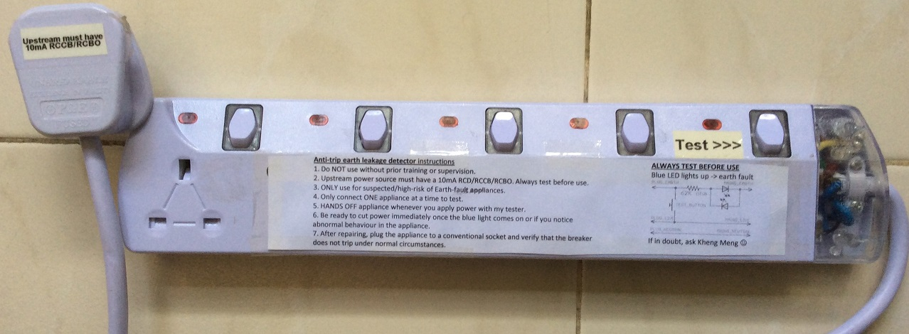
anti-trip-earth-leakage-detector (Demo)
Shows blue LED on earth fault, no breaker trip
Does not interrupt the work of others
Preserves lifespan of RCBO
Upstream must have 10mA RCBO
Familiarise with usage instructions beforehand

Slide 23
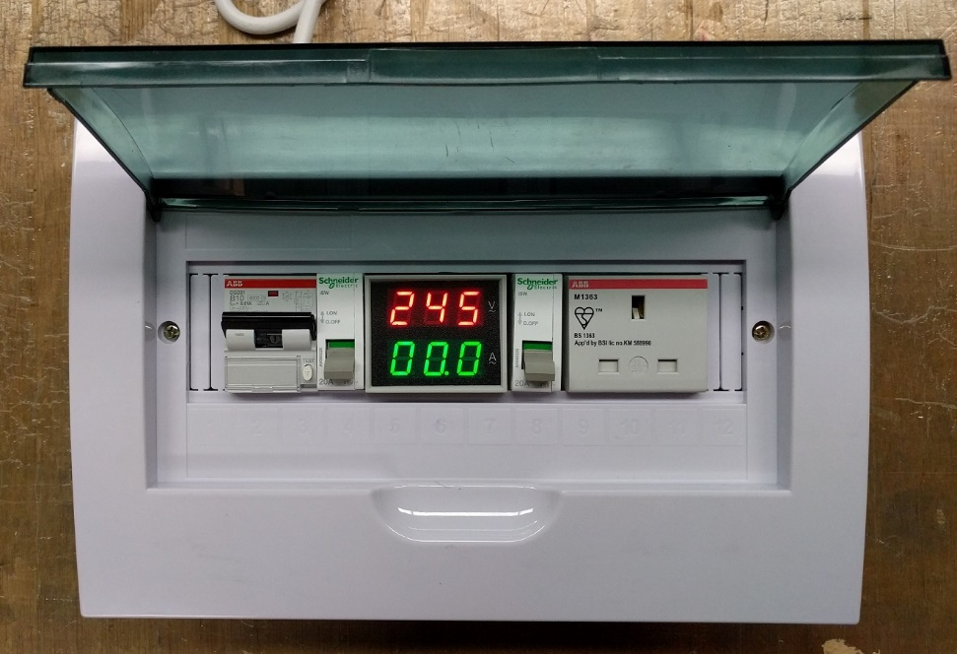
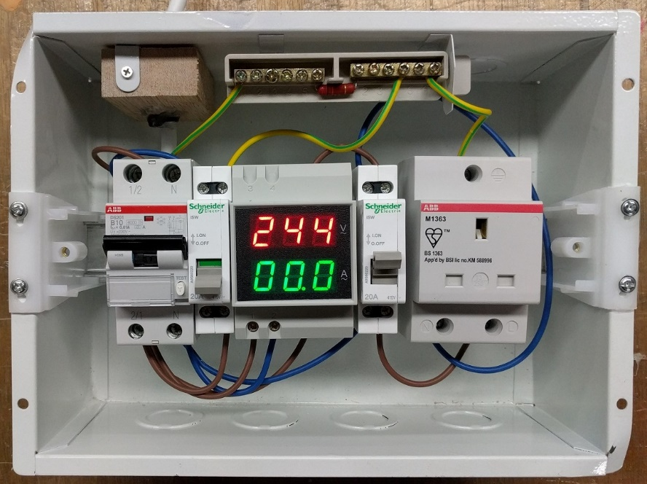
10ma-rcbo-and-anti-external-cb-trip (Demo)
Combines 10mA RCBO and trip-10ma-rccb-only-tool
anti-trip-earth-leakage-detector can still be used externally
Familiarise with usage instructions beforehand

Slide 24
General order of diagnosis
Advise participant about warranty. Then ask what is wrong, specifically if their ELCB trips
ELCB trips
If “anti-trip-earth-leakage-detector” is available, use it to determine if earth fault exists. Try to locate any short to Earth wire. Dismantle appliance if needed.
No trip
Connect to main power and try to power on
No Power
Check fuse for continuity
No Power
Diagnose component by component till you find the fault or give up
Dismantle part of appliance to reach the other end of power cable and test entire cable for continuity

Slide 25
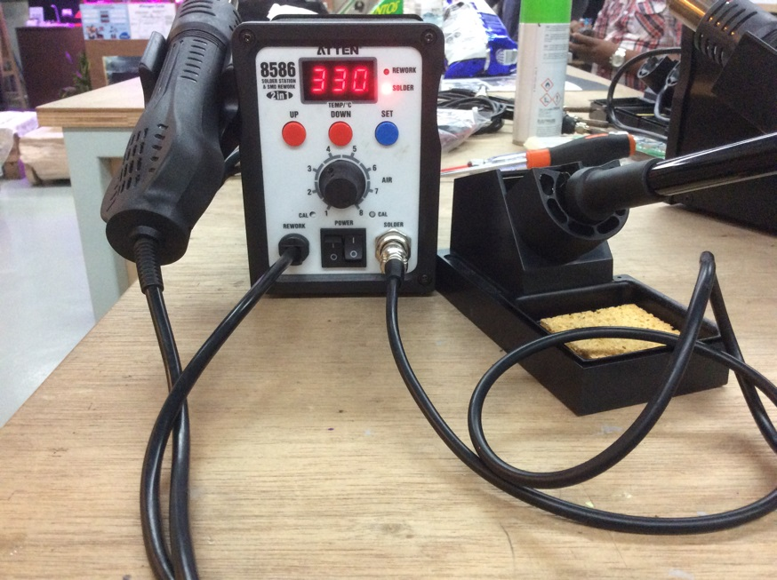
Stage 2
Safety
Order of Diagnosis
Multimeter recap
Test pen
Soldering
Wire-board
Wire-wire
Desoldering
Solder sucker
Hot-air gun
Solder wick

